Slide 1
Presentation 4:
Exploratory Deep Learning
Nathanial Hermann, Sophia Porretta, Matthew Ray, Nick Remen

Slide 2
Introduction To Our Project
Used data from the Department of Defense website and the US Office of Personnel Management public survey data
The US government conducts an annual survey across agencies, assessing employee engagement, global satisfaction, performance confidence, and diversity, equity, inclusion, and accessibility (DEIA).
Fluctuation in personnel numbers each year are influenced by diverse factors and reshaping the dynamics of the military.
Focus on predicting end strengths for various ranks across US military branches.
Army, Air Force, Navy, Marines, Space Force

Slide 3
Our Goal/Hypothesis
Utilizing survey data as human factors information, we aimed to forecast personnel transfers or exits from each agency. Our surveys contained over 1.5 Million responses.
Employed a neural network model trained on historical survey and end strength data, seeking to provide valuable insights into future end strengths for different military branch ranks, offering guidance for strategic planning.
Can a machine learning model effectively predict attrition among military branch personal?
Additionally, does the model reveal anticipated trends, such as decrease in ranks like First Lieutenant over time, corresponding to the known timing of contract expirations and military retirements?

Slide 4
Data Cleaning
Train a specific chat gpt-4 model to extract survey keys.
We started by reading in all CSV files containing Government survey and end strength data from years 2010 to 2023. We then merged the files into a dataframe using pandas
We had to implement a scaling function to adjust response values on a scale of 1 to 5 in order to reduce skewness in the models results.
Due to variation in the surveys, we had to categorize questions into discrete bins.
Work experience, work unit, organization, supervisor, leadership, satisfaction, employee experience, circumstantial, and DEIA
For each survey year a separate data frame was generated. Unnecessary demographic data was excluded, retaining only questions relevant to an individual’s intention to retire or leave an agency.
These individual data frames were merged into a comprehensive data frame, called ‘all_surveys’
DEIA started being tracked in 2022. For years preceding 2022 a random forest regressor was utilized to predict DEIA success.
The data was restructured and additional columns were added to prepare the final data frame for exports as a CSV file for training data

Slide 5
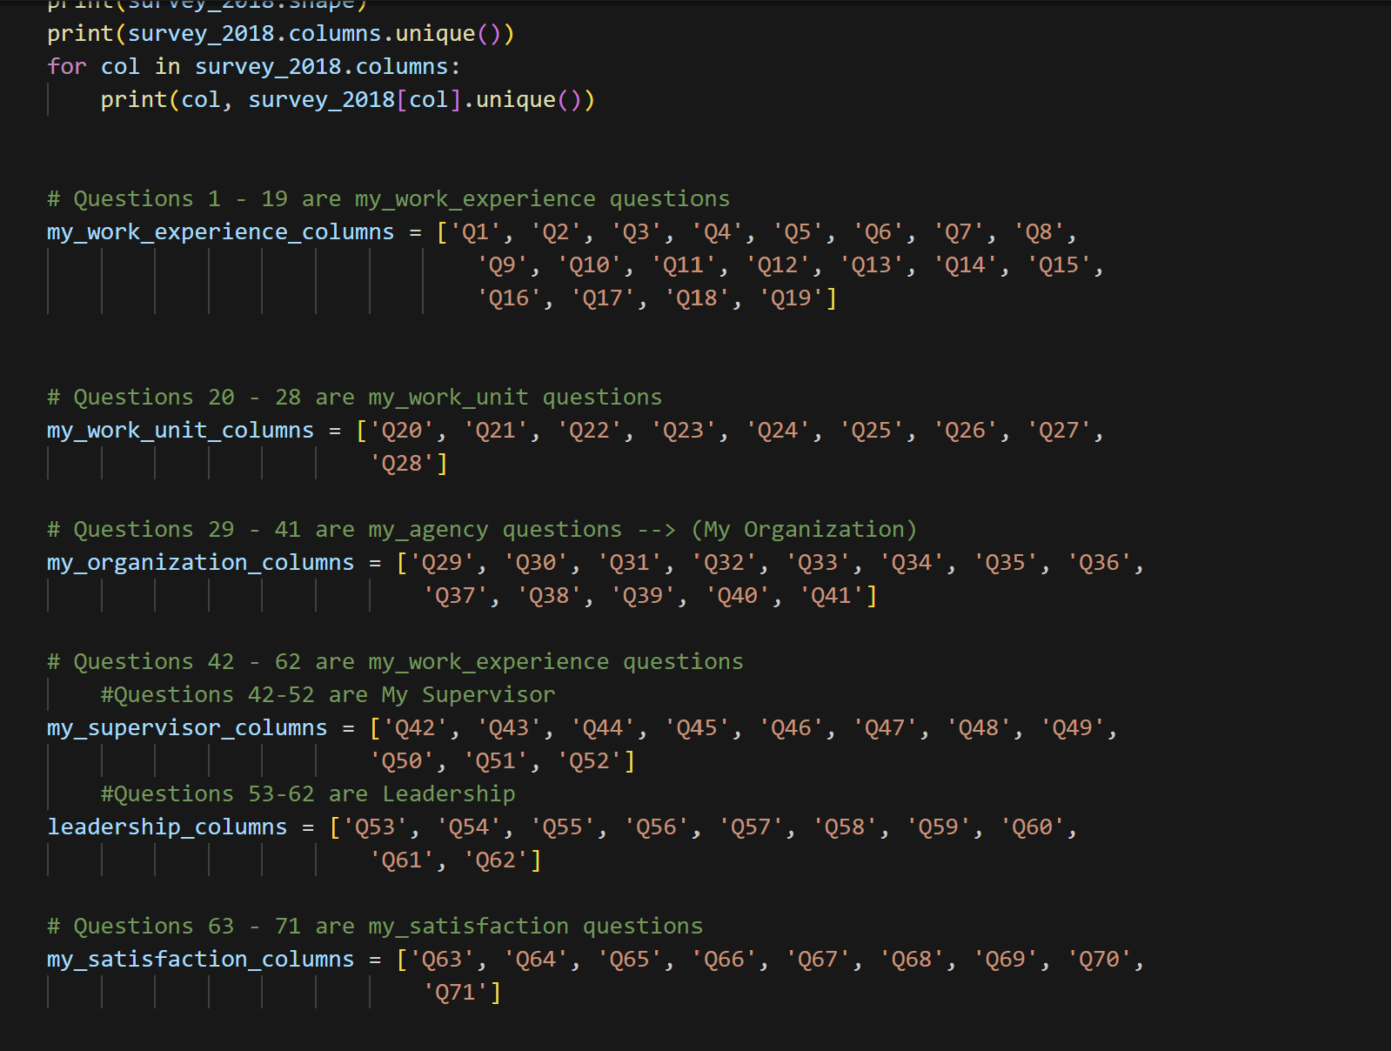
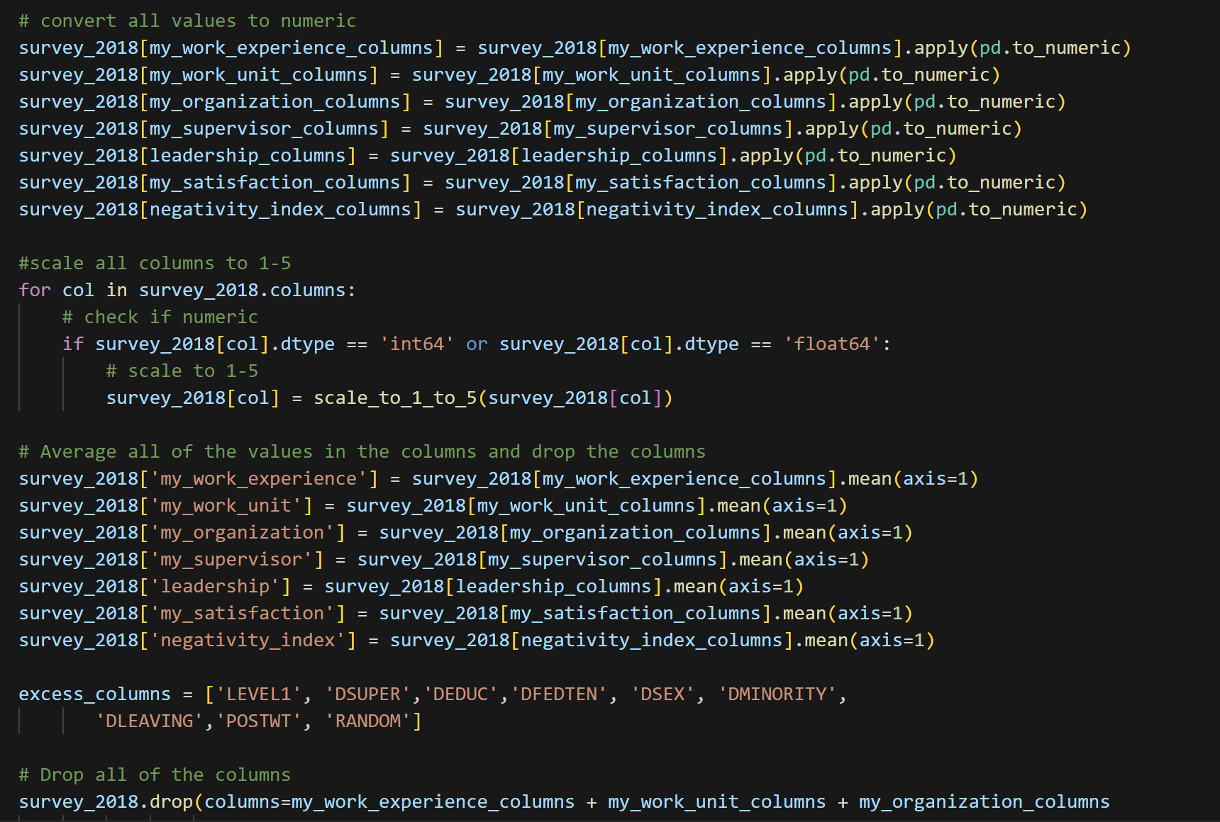

Slide 6
Data Assembly
Read in end strength data and looked at stats for all the survey data using .describe() - These features ultimately did not make the cut as they reduced model performance
training set Vs production set - we wanted to ensure our results were not bias and we set aside an entire years worth of data to conduct a real test
We created a data augmentation function, multiplying the dataset by 1000 to ensure a 0.1 variance of the normal distribution mean.
Used a cleaned dataframe to run different regression models to see if any perform well

Slide 7
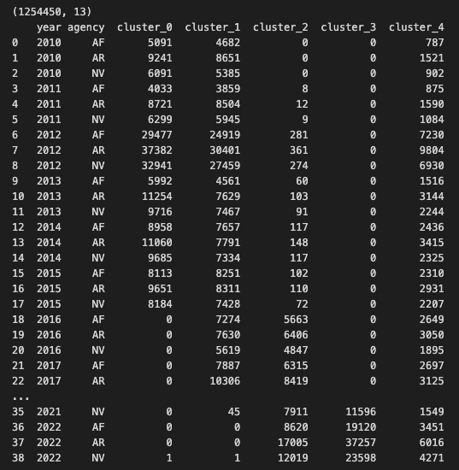
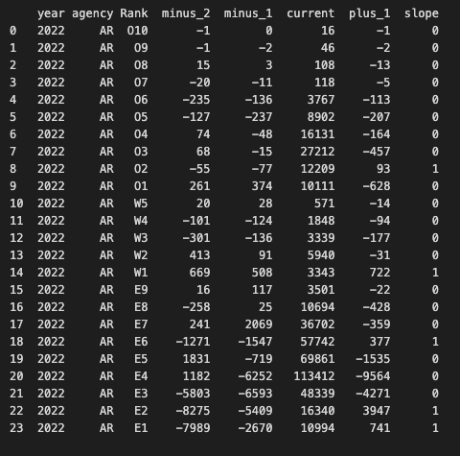
End Strength Data

Slide 8
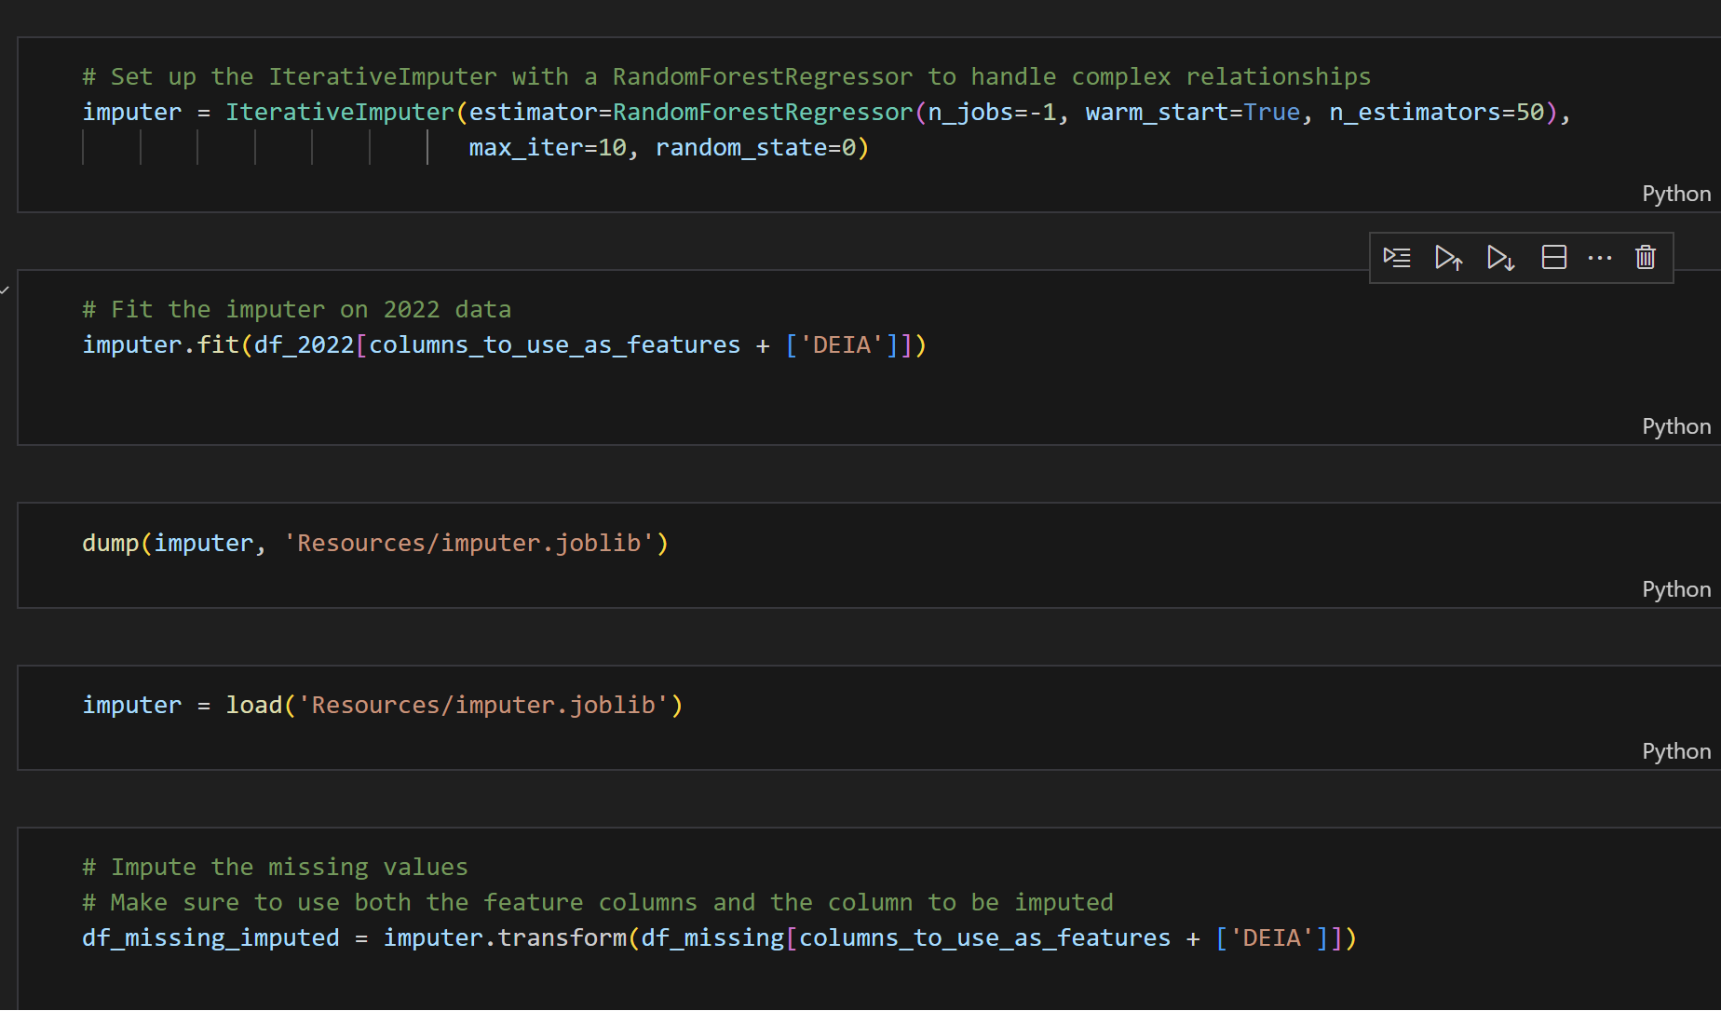
Model for DEIA population

Slide 9
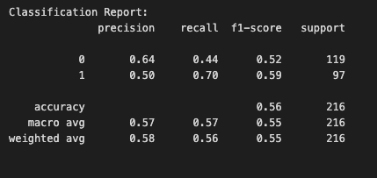
Logistic Regression Model

Slide 10
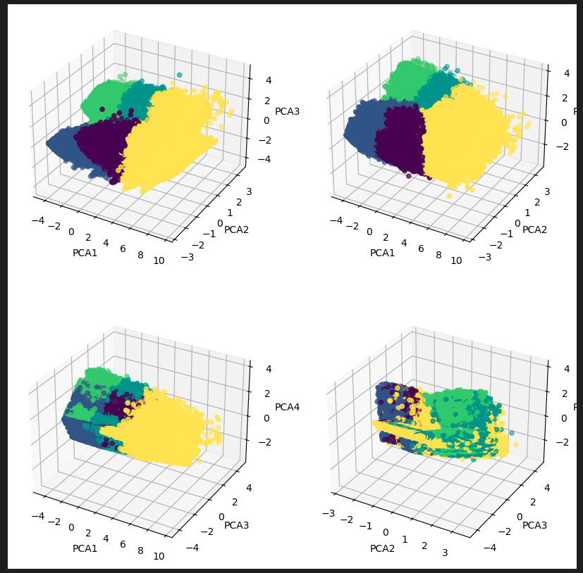
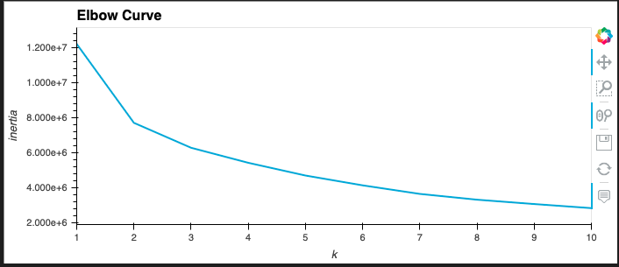
K Means Clustering

Slide 11
Data Assembly Continued
A Bayesian model was trained on 302,702 records and exhibited a 85% accuracy score, with a 53% validation accuracy score.
A Keras Tuner was employed to optimize hyperparameters, layers, accuracy, and dropout rate.
Predicting the number of epochs was challenging. Matplotlib aided in comparing validation and accuracy by using an area between the curves.
The Bayesian model demonstrated an improvement in accuracy from 10 to 17.5 epochs.
We employed early stopping to determine the optimal epoch count within the selected range

Slide 12
Phase 1
The saved model trained on data from 2010-2021, was applied to a production set (2022 data)
Used transfer learning to train the 2022 data on the model that was previously trained on the historic data and used the ensemble of all 5 models to predict whether each rank will increase or decrease in the following year for each branch

Slide 13
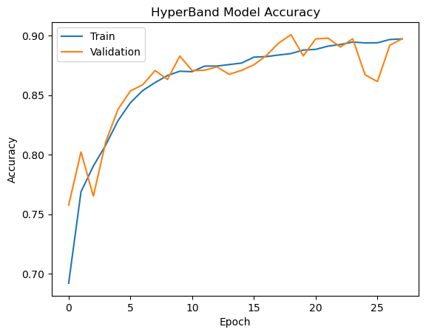
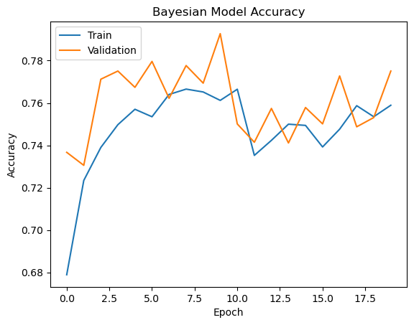
HyperBand and Bayesian Model Accuracy

Slide 14
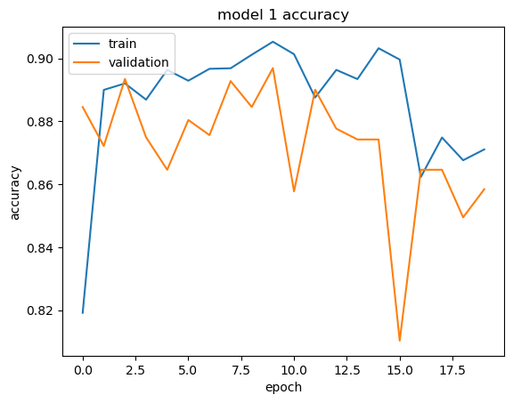
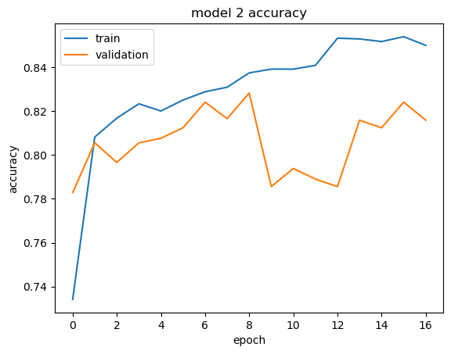
Model Accuracy

Slide 15
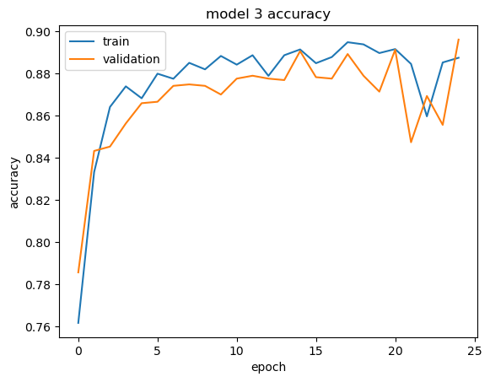
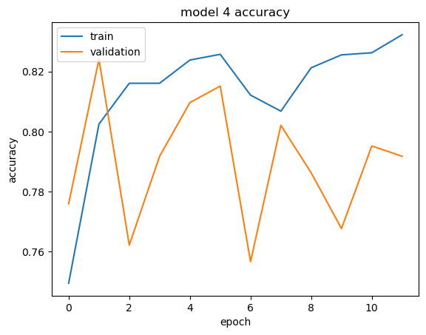
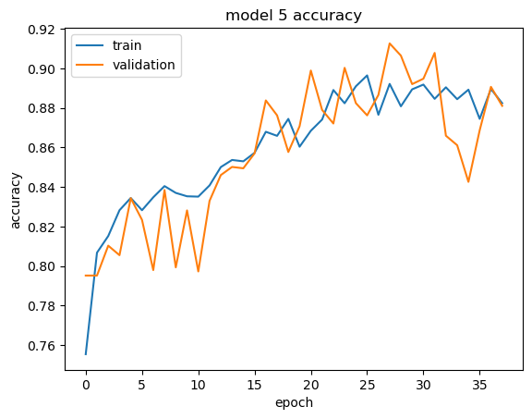
Model Accuracy

Slide 16
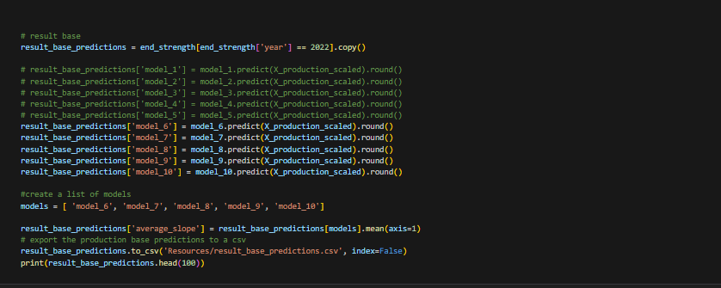

Slide 17
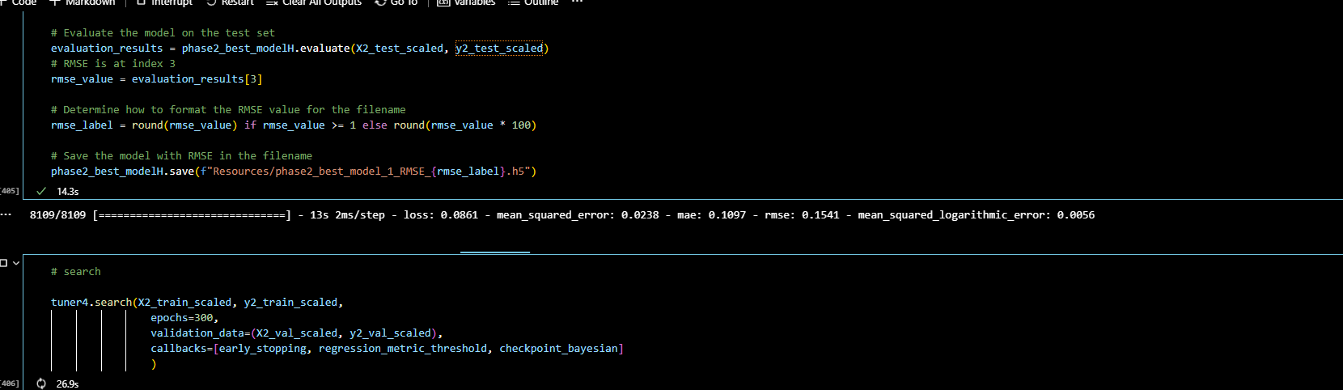
Phase 2
The second phase aimed to predict the actual number of personnel in the following year.
1 Model ran with very promising results. Total runtime was over 11 hours!
Subsequent models crashed from low memory, the regression model was too large.
Values were measured using mean squared error instead of accuracy in this phase.

Slide 18
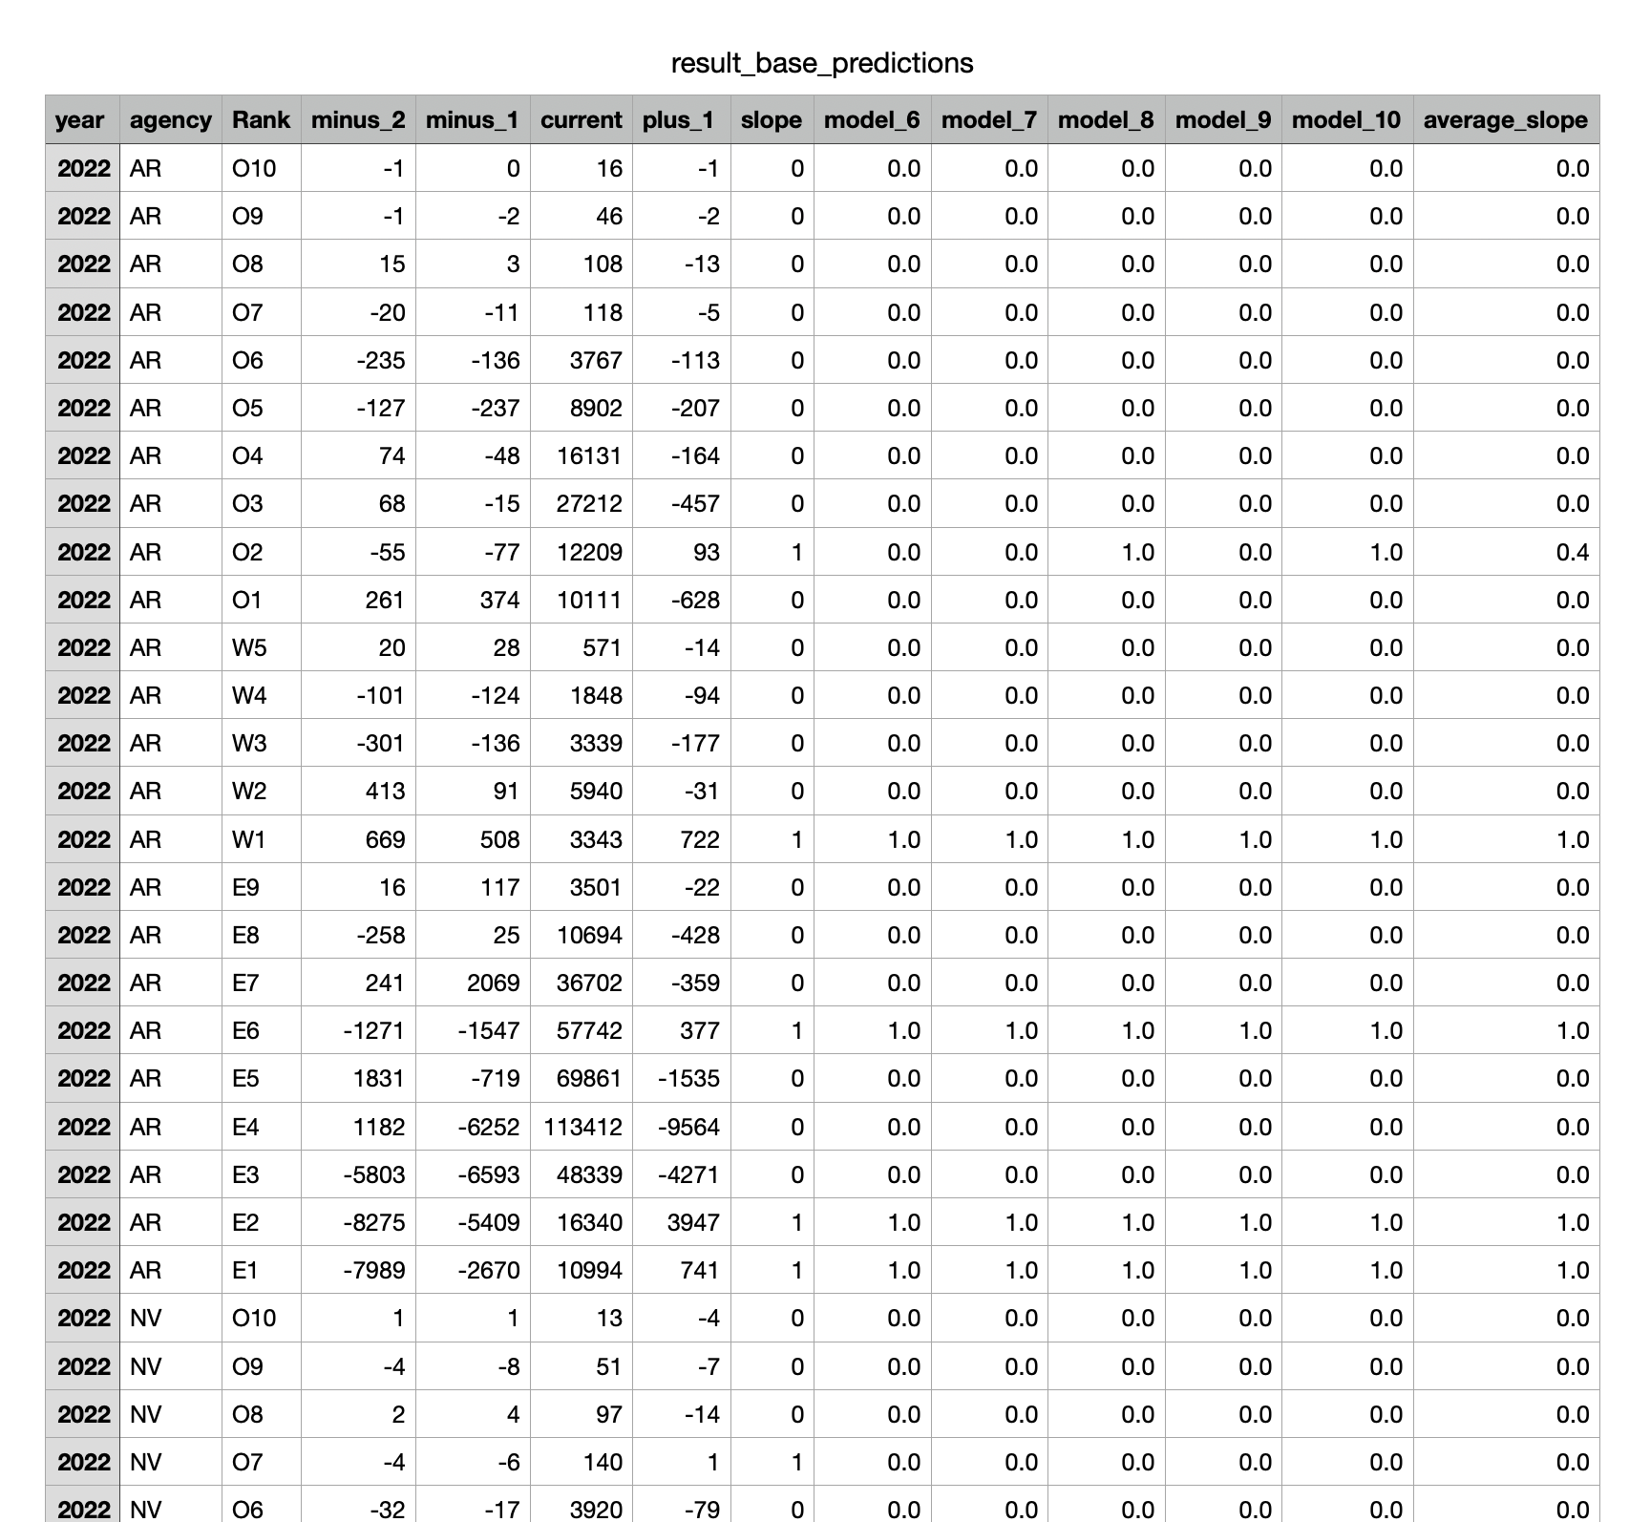
Conclusion

Slide 19
Data Sources
https://dwp.dmdc.osd.mil/dwp/app/main
https://www.opm.gov/fevs/reports/data-reports

